Slide 1
SUPERSTORE SALE ANALYSIS
Analysis ON A SUPERSTORE DATASET TO UNCOVER RELEVANT INSIGHTS

Slide 2
INTRODUCTION
This is an analysis on a superstore Dataset to find patterns, trends and provide insight in order to give informed Data-Driven decision that aligns with organizational goals.

Slide 3
OBJECTIVE
1. Evaluate highest performing region
2. Evaluate highest performing product
3. Analyze Trend of Sales
4. Determine customer segment performance
5. Find market with the most profit
6. Ascertain most used shipping mode and rate of shipping mode
7. Review the priority levels for different ship mode
8. Analyze trend of shipping cost

Slide 4
DATA PREPARATION
CLEANING:
The cleaning process was done in power query in which we checked for blanks, duplicate, spellings and inconsistencies. The data returned no blanks, duplicates, wrong spellings or Inconsistencies, each column were checked for right data type. It proves data quality and integrity.
Transformation:
The Data was separated into four different queries and the columns were re-ordered into the right format.
MODELING:
I created a relationship in Excel to connect all four queries to the fact table (ORDERS QUERIE) into order to carry out a PIVOT TABLE ANALYSIS.

Slide 5
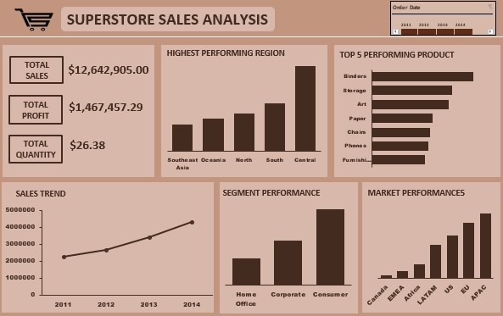
DASHBOARD VIEW

Slide 6
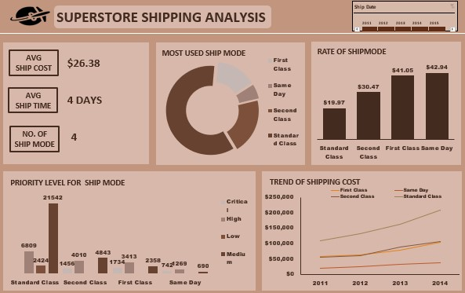

Slide 7
FINDINGS
1. Central region recorded the most performance across all regions.
2. Binders recorded the most performance by quantity sold.
3. There is an upward trend in sales through the years.
4. Consumer segment drive the most sales.
5. Most of company's profit come from 2 markets which are APAC and EU.
6. Standard Class is the most used ship mode with 60% which its driven by its lower ship rate while same day delivery has the highest rate but second to the last ship mode used.
7. While Standard class has the highest delivery priority, it also records the lowest priority. Critical priority delivery is mostly recorded for first class and second class ship mode.
8. cost of shipping face an upward trend for every ship most, which raises concerns for constant increase in shipping cost.

Slide 8
CONCLUSION AND RECOMMENDATION
1. Target Consumer Segment: Continue to prioritize the consumer segment, which drives the most sales, and explore opportunities to upsell or cross-sell.
2. Implement marketing strategy used in Central region on the least performing region in order to promote sales.
3. Push Binders Sales: Capitalize on the success of binders by exploring ways to increase their sales, such as targeted marketing or promotions.
4. Increase profit margin or reduce manufacturing cost in order to get a higher profit.
5. Review Shipping Modes: Analyze the shipping modes, particularly Same Day Delivery, to understand customer needs and optimize shipping strategies.
6. Review Shipping Modes: Analyze the shipping modes, particularly Same Day Delivery, to understand customer needs and optimize shipping strategies.
7. Optimize Shipping Costs: Investigate ways to mitigate the upward trend in shipping costs, especially for Standard Class, to maintain profitability.

Slide 9
THANK YOU

